Slide 1




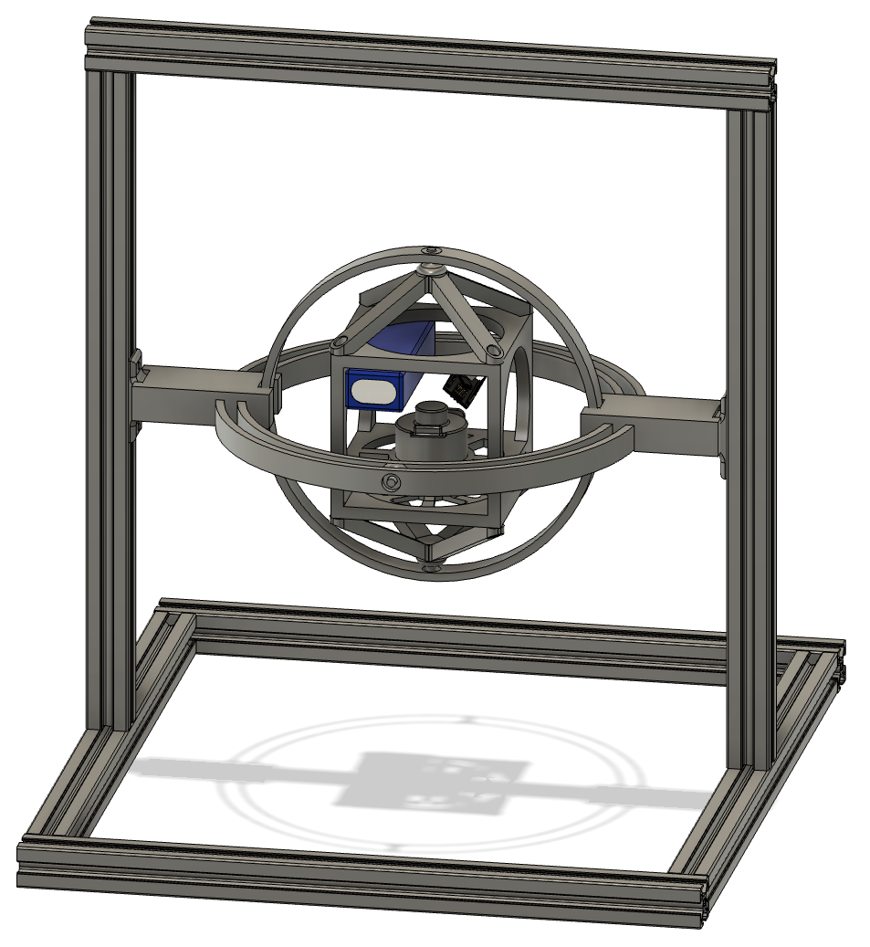
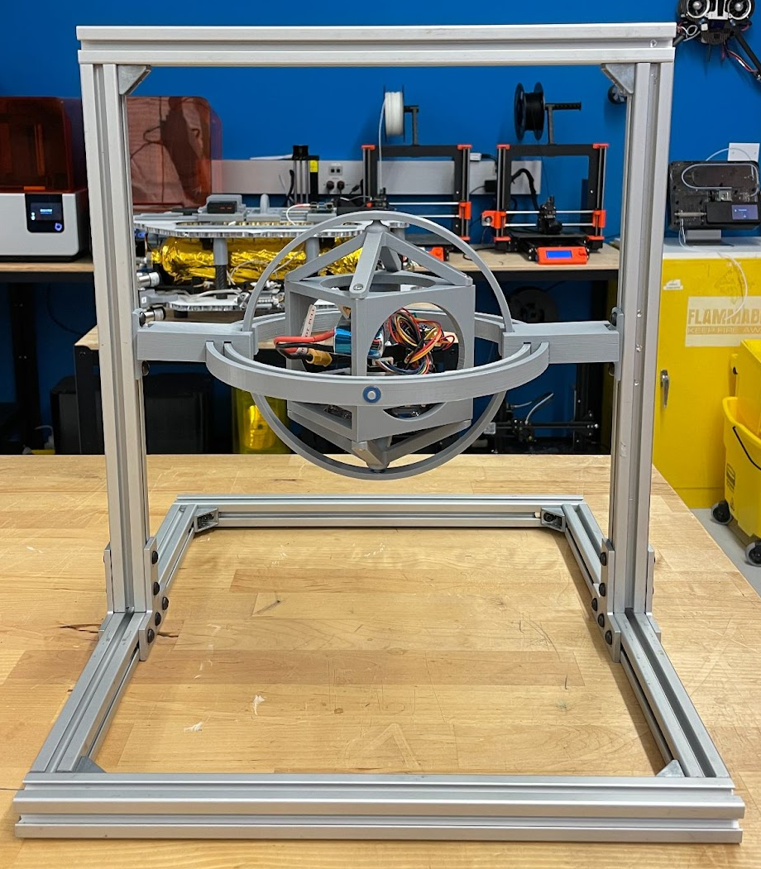
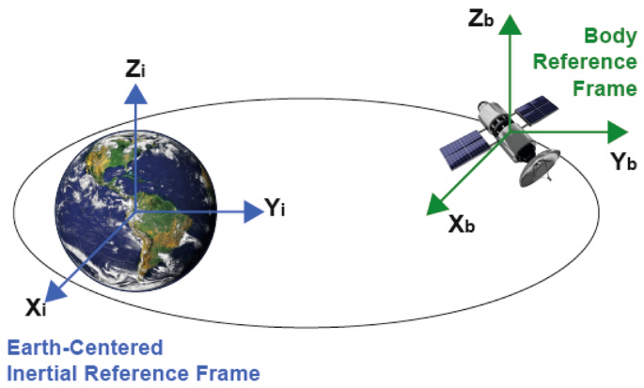
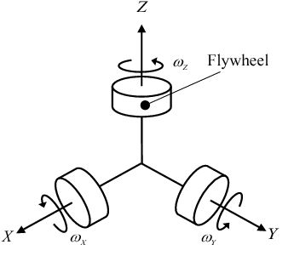
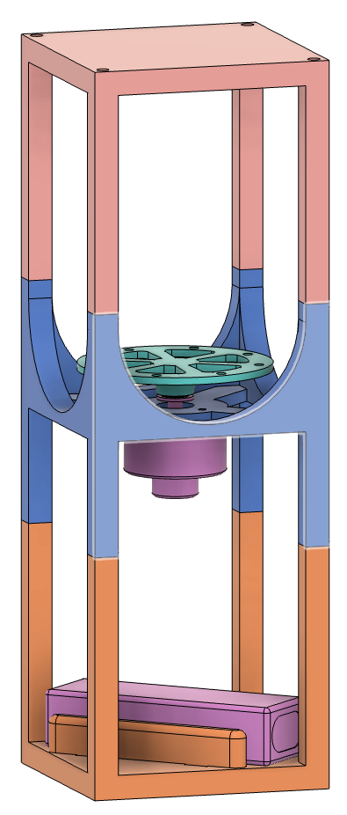
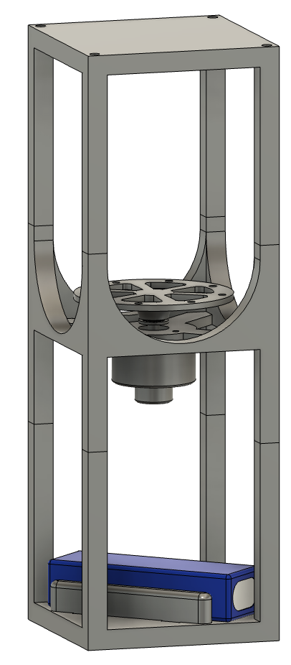
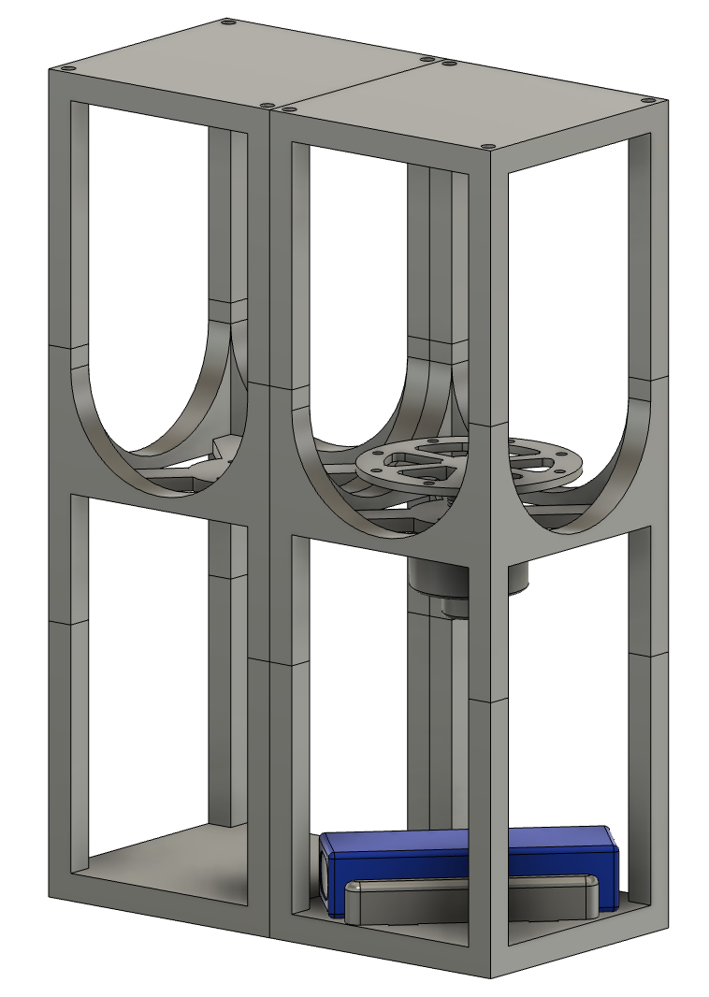
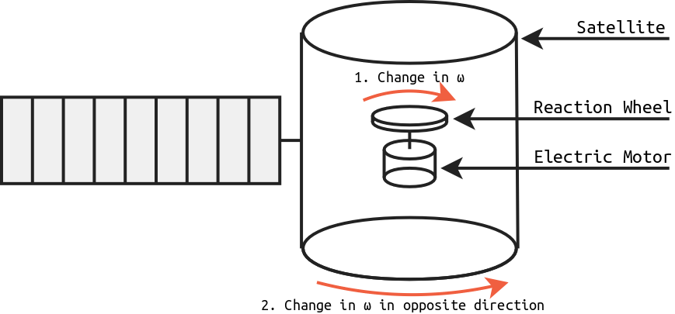
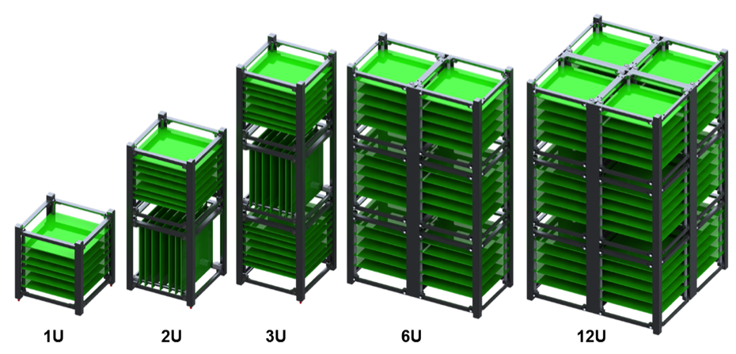
CubeSat Reaction Wheel
Attitude Control Platform
Dylan Ballback, Daniel Wilczak, Justin Hartland, Ella Cheatham, Daniel Golan
Abstract
Project Goals
Current State
In the classroom, learning the math behind spacecraft attitude control is math-intensive. It is common that students struggle to develop the connection between the math they are learning and visualizing how it could be applied to a real-world application.
The goal of this project is to design and manufacture a 1U, 3U, 6U CubeSat testbed for autonomous control systems utilizing reaction wheels. The testbed will include three separate reaction wheels each mounted on its own respected axis of the rotation plane to control the attitude in 3 degrees of freedom.
The end goal of the CubeSat testbed is to be integrated into a website where anyone online can upload their own controls algorithm and watch a live stream of how their algorithm performs on hardware in real-time.
Develop a 1U, 3U, and 6U CubeSat Reaction Wheel Attitude Control Platform.
Integrate CubeSat control into a website to allow anyone to upload their own control algorithm and watch a live stream to evaluate how it performs.
Prototype 1U CubeSat 3D printed and assembled.
Designed and assembled 1U CubeSat gimbal rings and test stand.
Achieved simple 1 degree of freedom PID controller.
Accomplished basic WebSocket wireless communication infrastructure between the CubeSat and a website to live stream data in real-time and send data from website.
CubeSat attitude control is to enable the CubeSat to point in the desired direction that is set in relation to a reference frame.
Significance
Methodology
Moving Forward
Working on design and 3D printing of the first prototype of the 3U and 6U CubeSat for 1 DOF control testing.
Developing design and assembly for 3U and 6U CubeSat gimbal rings and test stand.
The current process to learn CubeSat controls is vastly conceptual for students from the high school, undergraduate, and even graduate levels.
Building a testbed in a gimbal connected to the internet would allow students the opportunity to test their designs, theories, and software on real CubeSat hardware in real-time.
A use case for the testbed would be to integrate into the classroom while learning the math behind attitude controls.
Design and 3D print a 1U, 3U, and 6U CubeSat test bed.
Design and 3D print the 1U, 3U, and 6U gimbal ring assembly to allow for free rotation in 3 degrees of freedom.
Design and fabricate extruded aluminum test stand to hold gimbal and CubeSat assembly for 1U, 3U, and 6U CubeSat.
Develop the electronics/software to control reaction wheel motors and read IMU and motor encoder sensors.
Develop software infrastructure for wireless communication between website and CubeSat.
Develop example PID controller to control CubeSat attitude.
3U CubeSat CAD Prototype
6U CubeSat CAD Prototype
Notes:
To change this poster, replace our sample content with your own. Or, if you'd rather start from a clean slate, use the New Slide button on the Home tab to insert a new page, then enter your text and content in the empty placeholders. If you need more placeholders for titles, subtitles or body text, copy any of the existing placeholders, then drag the new one into place.

